Slide 1
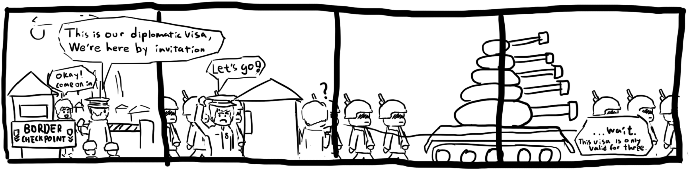
Memory Safety Vulnerabilities
CSE 405 Lecture 14

Slide 2
Last Time: x86 Assembly and Call Stack
C memory layout
Code section: Machine code (raw bits) to be executed
Static section: Static variables
Heap section: Dynamically allocated memory (e.g. from malloc)
Stack section: Local variables and stack frames
x86 registers
EBP register points to the top of the current stack frame
ESP register points to the bottom of the stack
EIP register points to the next instruction to be executed
x86 calling convention
When calling a function, the old EIP (RIP) is saved on the stack
When calling a function, the old EBP (SFP) is saved on the stack
When the function returns, the old EBP and EIP are restored from the stack
Notes:
Peyrin says “The more deeply you understand calling convention, the less time you’ll spend on project 1”.
1 hour -> start lec 3

Slide 3
Today: Memory Safety Vulnerabilities
Buffer overflows
Stack smashing
Memory-safe code
Integer memory safety vulnerabilities
Format string vulnerabilities
Heap vulnerabilities
Writing robust exploits

Slide 4
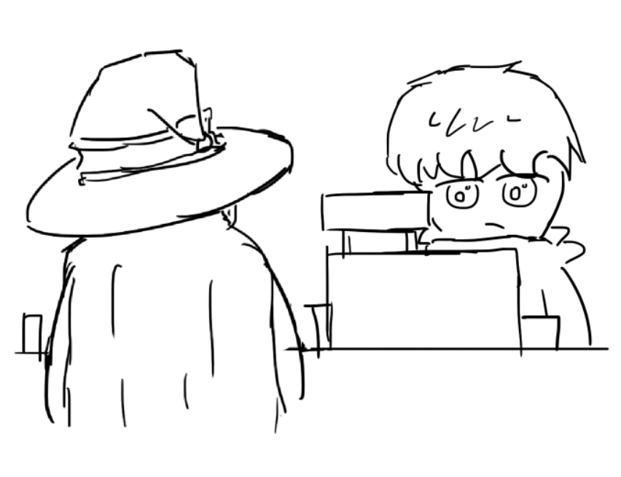

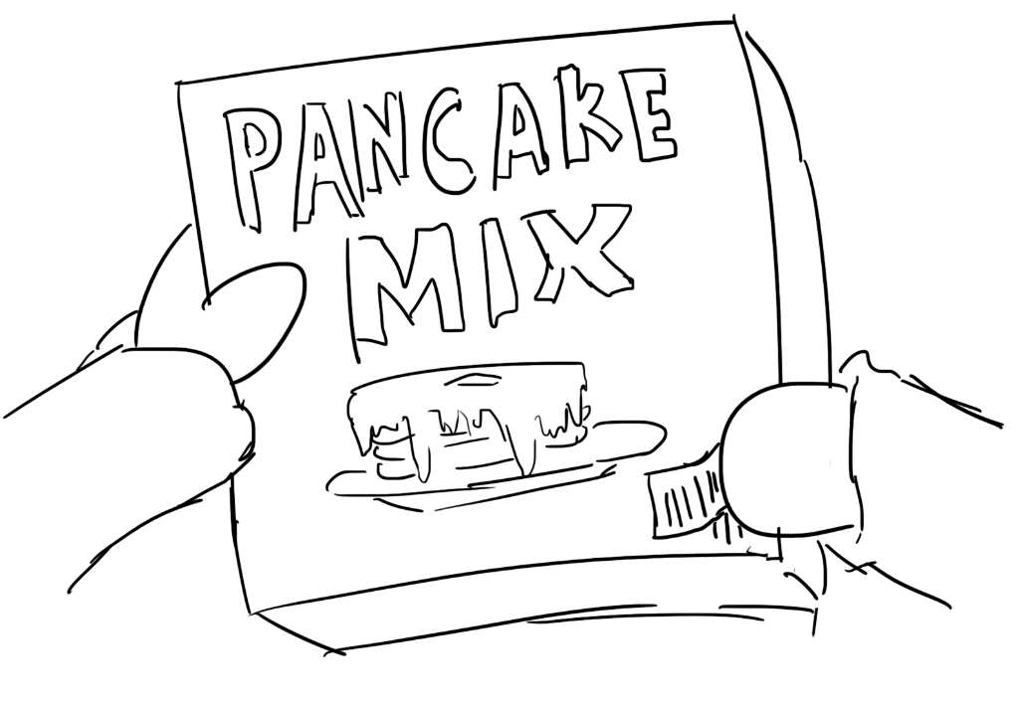
Buffer Overflow Vulnerabilities
Textbook Chapter 3.1

Slide 5
Buffer Overflow Vulnerabilities
Recall: C has no concept of array length; it just sees a sequence of bytes
If you allow an attacker to start writing at a location and don’t define when they must stop, they can overwrite other parts of memory!
char name[4];
name[5] = 'a';
 |  |  |  |  |  | a
name[0]
name[1]
name[2]
name[3]
name[5]
This is technically valid C code, because C doesn’t check bounds!
Notes:
Think back like an hour–memory is just one continuous block of 0s and 1s.
There’s no boundary in C between things in memory. This is valid! It will compile and run.

Slide 6
Vulnerable Code
What can go wrong here?
...
...
...
...
...
...
...
...
command
command
command
line
...
line
line
char line[512];
char command[] = "/usr/bin/ls";
int main(void) {
...
gets(line);
...
execv(command, ...);
}
Notes:
This one executes a command (ls, lists out all the files and directories in your computer). But now, we can execute something else… uh oh…

Slide 7
Vulnerable Code
What can go wrong here?
fnptr is called as a function, so the EIP jumps to an address of our choosing!
...
...
...
...
...
...
...
...
...
fnptr
name
name
name
name
name
char name[20];
int (*fnptr)(void);
void vulnerable(void) {
...
gets(name);
...
fnptr();
}
Notes:
This will motivate our next topic of stack smashing.
What’s a function pointer? It’s the address of an instruction somewhere else in memory. If I go to that address, there are instructions that you can execute. This could be a pointer to any function… but what if I could write my own function and clobber out the function pointer… oops :’))
Get ready for Thursday’s lecture!

Slide 8

Top 10 Most Dangerous Software Weaknesses (2023)
Rank | ID | Name | Score
[1] | CWE-787 | Out-of-bounds Write | 63.72
[2] | CWE-79 | Improper Neutralization of Input During Web Page Generation ('Cross-site Scripting') | 45.54
[3] | CWE-89 | Improper Neutralization of Special Elements used in an SQL Command ('SQL Injection') | 34.27
[4] | CWE-416 | Use After Free | 16.71
[5] | CWE-78 | Improper Neutralization of Special Elements used in an OS Command ('OS Command Injection') | 15.65
[6] | CWE-20 | Improper Input Validation | 15.50
[7] | CWE-125 | Out-of-bounds Read | 14.60
[8] | CWE-22 | Improper Limitation of a Pathname to a Restricted Directory ('Path Traversal') | 14.11
[9] | CWE-352 | Cross-Site Request Forgery (CSRF) | 11.73
[10] | CWE-434 | Unrestricted Upload of File with Dangerous Type | 10.41
Notes:
https://cwe.mitre.org/top25/archive/2023/2023_top25_list.html#top25list

Slide 9
Constructing Exploits
Place the shellcode after the RIP
This works because gets lets us write as many bytes as we want
What should the address be?
Input: 'A' * 24 + '\x5c\xcd\xff\xbf' + SHELLCODE
24 bytes of garbage
The address of where we placed the shellcode
28 bytes of shellcode
'\x00' | ... | ... | ...
SHELLCODE
SHELLCODE
SHELLCODE
SHELLCODE
SHELLCODE
SHELLCODE
SHELLCODE
'\x5c' | '\xcd' | '\xff' | '\xbf'
'A' | 'A' | 'A' | 'A'
'A' | 'A' | 'A' | 'A'
'A' | 'A' | 'A' | 'A'
'A' | 'A' | 'A' | 'A'
'A' | 'A' | 'A' | 'A'
'A' | 'A' | 'A' | 'A'
0xbfffcd5c
0xbfffcd58
0xbfffcd54
0xbfffcd50
0xbfffcd4c
0xbfffcd48
0xbfffcd44
0xbfffcd40
RIP
SFP
void vulnerable(void) {
char name[20];
gets(name);
}
name
Notes:
Another new address -> must line up with where we put our shellcode
The RIP is the next instruction to run after we return from the current function.
This shows that there are a lot of different patterns and ways you can perform stack smashing.

Slide 10
Constructing Exploits
Input: SHELLCODE + 'A' * 12 + '\x40\xcd\xff\xbf' + '\n'
12 bytes of shellcode
12 garbage bytes to overwrite the rest of name and the SFP of vulnerable
The address of where we placed the shellcode
... | ... | ... | ...
... | ... | ... | ...
... | ... | ... | ...
... | ... | ... | ...
... | ... | ... | ...
... | ... | ... | ...
... | ... | ... | ...
'\x00' | ... | ... | ...
'\x40' | '\xcd' | '\xff' | '\xbf'
'A' | 'A' | 'A' | 'A'
'A' | 'A' | 'A' | 'A'
'A' | 'A' | 'A' | 'A'
SHELLCODE
SHELLCODE
SHELLCODE
0xbfffcd5c
0xbfffcd58
0xbfffcd54
0xbfffcd50
0xbfffcd4c
0xbfffcd48
0xbfffcd44
0xbfffcd40
RIP
SFP
void vulnerable(void) {
char name[20];
gets(name);
}
name
Notes:
Remember each word is 4 bytes, so the shellcode takes up 3 words
This is our canonical stack smashing attack!
Okay, I know some of you are doubting me. How could someone know the addresses and the exact details of the stack? Well, remember shannon’s maxim (The enemy knows the system”) -> don’t rely on security through obscurity
Do not rely on the fact that the attacker may not know the system/could never breach it.

Slide 11
Constructing Exploits
Alternative: 'A' * 12 + SHELLCODE + '\x4c\xcd\xff\xbf' + '\n'
The address changed! Why?
We placed our shellcode at a different address (name + 12)!
... | ... | ... | ...
... | ... | ... | ...
... | ... | ... | ...
... | ... | ... | ...
... | ... | ... | ...
... | ... | ... | ...
... | ... | ... | ...
'\x00' | ... | ... | ...
'\x4c' | '\xcd' | '\xff' | '\xbf'
SHELLCODE
SHELLCODE
SHELLCODE
'A' | 'A' | 'A' | 'A'
'A' | 'A' | 'A' | 'A'
'A' | 'A' | 'A' | 'A'
0xbfffcd5c
0xbfffcd58
0xbfffcd54
0xbfffcd50
0xbfffcd4c
0xbfffcd48
0xbfffcd44
0xbfffcd40
RIP
SFP
void vulnerable(void) {
char name[20];
gets(name);
}
name
Notes:
Okay wait, so now there are different solutions?
Why did the address change?

Slide 12
Memory-Safe Code
Notes:
25 min

Slide 13
Still Vulnerable Code?
void vulnerable?(void) {
char *name = malloc(20);
...
gets(name);
...
}
Heap overflows are also vulnerable!
Notes:
This vulnerability exists everywhere. It’s vulnerable because we can overwrite values on the heap above that variable. How can you prevent this? We have cool safer C library functions.

Slide 14
Solution: Specify the Size
void safe(void) {
char name[20];
...
fgets(name, 20, stdin);
...
}
The length parameter specifies the size of the buffer and won’t write any more bytes—no more buffer overflows!
Warning: Different functions take slightly different parameters
Notes:
Now the user can only write 20 bytes (this includes the null terminator). Basically, it will read up to 19 bytes and then append a null byte.
Remember strings in C have to be null terminated.

Slide 15
Solution: Specify the Size
void safer(void) {
char name[20];
...
fgets(name, sizeof(name), stdin);
...
}
sizeof returns the size of the variable (does not work for pointers)
Notes:
For instance, sizeof(name) here because name is a declared array of 20 chars = 20 bytes, which is fixed at compile time. It doesn’t matter if there are no characters or if the char array houses 20 chars, it will always be of size 20. However, if we used char* and stored “Evanbot” (so a pointer), it would always be 4 in a 32-bit system even though the string “Evanbot” is 7 chars = 7 bytes? Remember pointers are just addresses which are 4 bytes!

Slide 16
Vulnerable C Library Functions
gets - Read a string from stdin
Use fgets instead
strcpy - Copy a string
Use strncpy (more compatible, less safe) or strlcpy (less compatible, more safe) instead
strlen - Get the length of a string
Use strnlen instead (or memchr if you really need compatible code)
… and more (look up C functions before you use them!)
man pages are your friend!
Notes:
Now you may ask why does the vulnerable version exist? Legally–most likely gets was created first and it still needs to be valid for backwards compatibility reasons.

Slide 17
Integer Memory Safety Vulnerabilities
Textbook Chapter 3.4
Notes:
Okay, well we’ve finished the canonical buffer overflow attack. But there’s so many more now! The world is your oyster (not legally, just in this class)

Slide 18
Signed/Unsigned Vulnerabilities
Is this safe?
void func(int len, char *data) {
char buf[64];
if (len > 64)
return;
memcpy(buf, data, len);
}
int is a signed type, but size_t is an unsigned type. What happens if len == -1?
This is a signed comparison, so len > 64 will be false. But when we call memcpy(), casting -1 to an unsigned type yields 0xffffffff: another buffer overflow!
void *memcpy(void *dest, const void *src, size_t n);
Notes:
Buffer of size 64
Our if condition checks whether the length is greater than 64
Mem copy from data into buf (look into man pages if you’re ever stuck)
Looks fine on first glance right. But no (lol)
Size_t is unsigned
Int is signed
Okay… does that matter? Well remember, that memory is really just a long continuous block of 0s and 1s (I know i’ve said that a lot, but it’s true and important!) This means that the data underlying the signed and unsigned values is the same and will not change. Okay, well what is -1 actually stored as?
If len is -1 -> this is all 1s -> so in signed land, it’s -1, but in unsigned land, it is literally the largest possible 8 byte number, which is 2^32 -1
This is 61c material, we don’t really care about the fact of whether you can calculate this or not

Slide 19
Signed/Unsigned Vulnerabilities
void safe(size_t len, char *data) {
char buf[64];
if (len > 64)
return;
memcpy(buf, data, len);
}
Now this is an unsigned comparison, and no casting is necessary!
Notes:
To be safe, change the int to a size_t. Now, we’d be comparing 2^32 - 1 > 64, which is true, and thus we’d return without memcpying that atrociously large data into our buffer.

Slide 20
Integer Overflow Vulnerabilities
Is this safe?
What happens if len == 0xffffffff?
void func(size_t len, char *data) {
char *buf = malloc(len + 2);
if (buf == NULL)
return;
memcpy(buf, data, len);
buf[len] = '\n';
buf[len + 1] = '\0';
}
len + 2 == 1, enabling a heap overflow!
Notes:
Another number problem.
Remember that if we take the largest number possible, then it wraps back around to 0, so if we add 2, that’s 1.
This means we’ve only malloc’d 1 byte for the buffer, but we’re copying 2^32-1 bytes into buf, which leads to a heap overflow.

Slide 21
Integer Overflow Vulnerabilities
void safe(size_t len, char *data) { if (len > SIZE_MAX - 2)
return;
char *buf = malloc(len + 2);
if (buf == NULL)
return;
memcpy(buf, data, len);
buf[len] = '\n';
buf[len + 1] = '\0';
}
It’s clunky, but you need to check bounds whenever you add to integers!
Notes:
This is the safer version.
Moral of the story is there is a lot of error checking in this class (and in secure code in general).

Slide 22

Integer Overflow in the Wild
9 to 5 Linux | Link
New Linux Kernel Vulnerability Patched in All Supported Ubuntu Systems, Update Now
Marius Nestor | January 19, 2022
Discovered by William Liu and Jamie Hill-Daniel, the new security flaw (CVE-2022-0185) is an integer underflow vulnerability found in Linux kernel’s file system context functionality, which could allow an attacker to crash the system or run programs as an administrator.
Notes:
https://9to5linux.com/new-linux-kernel-vulnerability-patched-in-all-supported-ubuntu-systems-update-now

Slide 23
How Does This Vulnerability Work?
The entire kernel (operating system) patch: – if (len > PAGE_SIZE - 2 - size) + if (size + len + 2 > PAGE_SIZE) return invalf(fc, "VFS: Legacy: Cumulative options too large)
Why was the original code (len > PAGE_SIZE - 2 - size) vulnerable?
Notes:
This is literally the vulnerability that we just talked about!

Slide 24
How Does This Vulnerability Work?
The entire kernel (operating system) patch: – if (len > PAGE_SIZE - 2 - size) + if (size + len + 2 > PAGE_SIZE) return invalf(fc, "VFS: Legacy: Cumulative options too large)
Why was the original code (len > PAGE_SIZE - 2 - size) vulnerable?
PAGE_SIZE, size, and len are unsigned
Notes:
This is literally the vulnerability that we just talked about!

Slide 25
How Does This Vulnerability Work?
The entire kernel (operating system) patch: – if (len > PAGE_SIZE - 2 - size) + if (size + len + 2 > PAGE_SIZE) return invalf(fc, "VFS: Legacy: Cumulative options too large)
Why was the original code (len > PAGE_SIZE - 2 - size) vulnerable?
PAGE_SIZE, size, and len are unsigned
If size is larger than PAGE_SIZE, then PAGE_SIZE - 2 - size will trigger a negative overflow to 0xFFFFFFFF
Result: An attacker can bypass the length check and write data into the kernel
Notes:
This is literally the vulnerability that we just talked about!

Slide 26
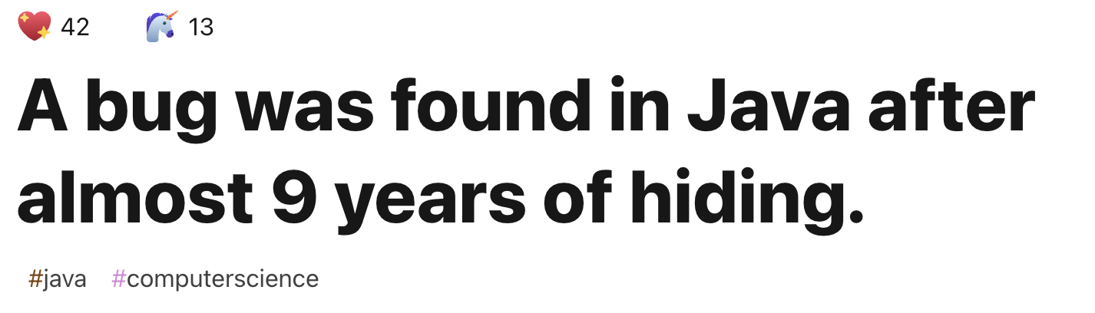
Java’s Binary Search Integer Overflow
https://dev.to/matheusgomes062/a-bug-was-found-in-java-after-almost-9-years-of-hiding-2d4k

Slide 27
Java’s Binary Search Integer Overflow
int mid =(low + high) / 2;
int mid = low + ((high - low) / 2);
❌
✅

Slide 28
Format String Vulnerabilities
Textbook Chapter 3.3
Notes:
The core problem of memory safety is that C doesn’t check bounds! This one’s kind of convoluted though, so I might be going a little quick but I really highly encourage you to go through these slides again.

Slide 29
printf behavior
printf accepts a variable number of arguments
How does it know how many arguments that it received?
It infers it from the first argument: the format string!
Example: printf("One %s costs %d", fruit, price)
What happens if the arguments are mismatched?
Notes:
Printf, one of my favorite functions (maybe some of yours too, if you love print debugging–there’s no shame in that, I am a believer as well).
Well if you’re like me, most of the time your printf statements might not be this in depth (normally it’s just one string), but printf functions very differently than the print function in python would because it takes in many arguments (beyond just string concatenation)!
Plugs in from the placeholders.
%s - string, %d - signed decimal, %x - hex
C doesn’t actually perform any checks on the number of arguments… are we seeing a trend?

Slide 30
printf behavior
...
...
...
...
RIP for func
SFP for func
secret = 42
123 (arg to printf)
&"%d\n" (arg to printf)
RIP for printf
SFP for printf
[printf frame]
void func(void) {
int secret = 42;
printf("%d\n", 123);
}
arg1
arg0
printf assumes that there is 1 more argument because there is one format specifier (%d), so it will look 4 bytes up the stack for the argument
What if there is no argument?
'%' | 'd' | '\n' | '\0'
Notes:
We create a stack frame for printf… think back to calling convention
Push args
Push pointer to string “%d\n”
rip/sfp …
Well here’s a nice printf (because C is too trusting and assumes that the number of args is correct)
Okay, well this is really important for Project 1
Printf takes in arg0 and whenever it sees a modifier (so something that starts with a %), it traverses up the stack to read as arguments starting from the SECOND one (since the first one was the format string itself)

Slide 31
printf behavior
...
...
...
...
RIP for func
SFP for func
secret = 42
&"%d\n" (arg to printf)
RIP for printf
SFP for printf
[printf frame]
void func(void) {
int secret = 42;
printf("%d\n");
}
arg1
arg0
Because the format string contains the %d, it will still look 4 bytes up -- and print the value of secret!
'%' | 'd' | '\n' | '\0'
Notes:
Well what if the C code didn’t actually include the argument. We’re expecting one but uh oh… there’s no extra argument so we’re just going to leak the secret. Yikes…
Arguments were mismatched!
Compiler may throw a warning, but this is still valid syntax. So now we’d be printing out the number 42…
Okay so this might not happen as much in the wild because you’re probably going to include the arguments if you’re writing them out like this but…

Slide 32
Format String Vulnerability Walkthrough
Input: %d%s
char buf[64];
void vulnerable(void) {
char *secret_string = "pancake";
int secret_number = 42;
if (fgets(buf, 64, stdin) == NULL)
return;
printf(buf);
}
...
RIP for vulnerable
SFP for vulnerable
secret_string
secret_number
buf (arg to printf)
RIP for printf
SFP for printf
[printf frame]
Output:
42pancake
arg2
arg1
arg0
We’re calling printf("%d%s"). printf reads its first argument (arg0), sees two format specifiers, and expects two more arguments (arg1 and arg2).
'\0'
'%' | 'd' | '%' | 's'
'a' | 'k' | 'e' | '\0'
'p' | 'a' | 'n' | 'c'

Slide 33
Format String Vulnerabilities
printf can also write values using the %n specifier
%n treats the next argument as a pointer and writes the number of bytes printed so far to that address (usually used to calculate output spacing)
printf("item %d:%n", 3, &val) stores 7 in val
printf("item %d:%n", 987, &val) stores 9 in val
printf("000%n")
Writes the value 3 to the memory location pointed to by address located 8 bytes above the RIP of printf
void vulnerable(void) {
char buf[64];
if (fgets(buf, 64, stdin) == NULL)
return;
printf(buf);
}
Notes:
Okay but somehow it gets worse. Did you know printf can write stuff into memory instead of just reading? Yeah… guess we can use it for more than just print debugging lol.
Okay, I’m going to go through this multiple times because it’s kind of confusing.
Honestly, the best guess we have as to why people would use this is to make pretty aligned printf statements? But this is like a playground for attackers because now in printf calls, we can write into the stack.

Slide 34
Format String Vulnerability Walkthrough
Input: %d%n
char buf[64];
void vulnerable(void) {
char *secret_string = "pancake";
int secret_number = 42;
if (fgets(buf, 64, stdin) == NULL)
return;
printf(buf);
}
...
RIP for vulnerable
SFP for vulnerable
secret_string
secret_number
buf (arg to printf)
RIP for printf
SFP for printf
[printf frame]
Output:
arg2
arg1
arg0
We’re calling printf("%d%n"). printf reads its first argument (arg0), sees two format specifiers, and expects two more arguments (arg1 and arg2).
'\0'
'%' | 'd' | '%' | 'n'
'a' | 'k' | 'e' | '\0'
'p' | 'a' | 'n' | 'c'
Notes:
1 hour

Slide 35
Format String Vulnerability Walkthrough
Input: %d%n
char buf[64];
void vulnerable(void) {
char *secret_string = "pancake";
int secret_number = 42;
if (fgets(buf, 64, stdin) == NULL)
return;
printf(buf);
}
...
RIP for vulnerable
SFP for vulnerable
secret_string
secret_number
buf (arg to printf)
RIP for printf
SFP for printf
[printf frame]
Output:
42
arg2
arg1
arg0
The first format specifier %d says to treat the next argument (arg1) as an integer and print it out.
'\0'
'%' | 'd' | '%' | 'n'
'a' | 'k' | 'e' | '\0'
'p' | 'a' | 'n' | 'c'

Slide 36
Format String Vulnerability Walkthrough
Input: %d%n
char buf[64];
void vulnerable(void) {
char *secret_string = "pancake";
int secret_number = 42;
if (fgets(buf, 64, stdin) == NULL)
return;
printf(buf);
}
...
RIP for vulnerable
SFP for vulnerable
secret_string
secret_number
buf (arg to printf)
RIP for printf
SFP for printf
[printf frame]
Output:
42
arg2
arg1
arg0
The second format specifier %n says to treat the next argument (arg2) as a pointer, and write the number of bytes printed so far to the address at arg2.
We've printed 2 bytes so far, so the number 2 gets written to secret_string.
'\0'
'%' | 'd' | '%' | 'n'
'a' | 'k' | 'e' | '\0'
0x02 | 0x00 | 0x00 | 0x00
Notes:
Fixed during live lecture, FA23: The input on this slide mistakenly said %s, not %n.
Overwrite the panc into the integer 2 in little-endian.

Slide 37
Format Strings: Stack Diagram
void vulnerable(void) {
char buf[16];
char str[12];
fgets(buf, 16, stdin);
printf(buf);
}
...
RIP for vulnerable
SFP for vulnerable
buf
buf
buf
buf
str
str
str
buf (arg to printf)
RIP for printf
SFP for printf
[printf frame]
This is the stack diagram while printf is being called.
Where does printf look for arguments?
Notes:
Why is there no fgets stack frame?
It completed execution and returned!
Also why is it &buf? Well, we’re not going to pass the entire 16 byte buffer, but rather just the address of it.
Now, let’s think like printf. What are the arguments that printf thinks are on the stack? Okay, well I know my format string is arg 0 and then everything after that is used as arguments to match with format string modifiers (next slide)

Slide 38
Format Strings: Stack Diagram
void vulnerable(void) {
char buf[16];
char str[12];
fgets(buf, 16, stdin);
printf(buf);
}
...
RIP for vulnerable
SFP for vulnerable
buf |  |  |  | arg7
buf |  |  |  | arg6
buf |  |  |  | arg5
buf |  |  |  | arg4
str |  |  |  | arg3
str |  |  |  | arg2
str |  |  |  | arg1
buf (arg to printf) |  |  |  | arg0
RIP for printf
SFP for printf
[printf frame]
We’ve labeled which values in memory printf will interpret as arguments.
For example, if buf has 4 percent formatters, printf will match the last percent formatter with arg4.
Notes:
There’s a printf pointer (we don’t know exactly how though because we don’t have the source code for printf).

Slide 39
Write 100 to 0xdeadbeef
void vulnerable(void) {
char buf[16];
char str[12];
fgets(buf, 16, stdin);
printf(buf);
}
Attack scenario: Write the number 100 to memory address 0xdeadbeef.
What input should the attacker supply?
...
RIP for vulnerable
SFP for vulnerable
buf |  |  |  | arg7
buf |  |  |  | arg6
buf |  |  |  | arg5
buf |  |  |  | arg4
str |  |  |  | arg3
str |  |  |  | arg2
str |  |  |  | arg1
buf (arg to printf) |  |  |  | arg0
RIP for printf
SFP for printf
[printf frame]
Notes:
%n

Slide 40
Write 100 to 0xdeadbeef
void vulnerable(void) {
char buf[16];
char str[12];
fgets(buf, 16, stdin);
printf(buf);
}
Recall: When printf sees a %n, it takes the next unused argument, treats it like an address, and writes the number of bytes printed so far to that address.
When printf sees the %n, two things need to be true:
Control where we write: The next unused argument on the stack should be 0xdeadbeef.
Control what we write: The number of bytes printed so far should be 100.
...
RIP for vulnerable
SFP for vulnerable
buf |  |  |  | arg7
buf |  |  |  | arg6
buf |  |  |  | arg5
buf |  |  |  | arg4
str |  |  |  | arg3
str |  |  |  | arg2
str |  |  |  | arg1
buf (arg to printf) |  |  |  | arg0
RIP for printf
SFP for printf
[printf frame]
Notes:
Two things to juggle:
Where we’re writing–we need a %n to align with 0xdeadbeef
What we’re writing–we need to ensure that by the time we hit that %n, we’ve written 3 characters

Slide 41
Write 100 to 0xdeadbeef
void vulnerable(void) {
char buf[16];
char str[12];
fgets(buf, 16, stdin);
printf(buf);
}
When printf sees the %n, two things need to be true:
Control where we write: The next unused argument on the stack should be 0xdeadbeef.
Control what we write: The number of bytes printed so far should be 100.
Consider this exploit. What does it look like in memory?
...
RIP for vulnerable
SFP for vulnerable
buf |  |  |  | arg7
buf |  |  |  | arg6
buf |  |  |  | arg5
buf |  |  |  | arg4
str |  |  |  | arg3
str |  |  |  | arg2
str |  |  |  | arg1
buf (arg to printf) |  |  |  | arg0
RIP for printf
SFP for printf
[printf frame]
Input: | 0xdeadbeef | %94c | %c | %c | %n
Notes:
Maybe this works?

Slide 42
Write 100 to 0xdeadbeef
void vulnerable(void) {
char buf[16];
char str[12];
fgets(buf, 16, stdin);
printf(buf);
}
When writing to memory, the percent formatters take up multiple bytes of memory.
For example, %94c is 4 characters and takes up 4 bytes of memory.
...
RIP for vulnerable
SFP for vulnerable
(buf) %n |  |  |  | arg7
(buf) %c%c |  |  |  | arg6
(buf) %94c |  |  |  | arg5
(buf) 0xdeadbeef |  |  |  | arg4
str |  |  |  | arg3
str |  |  |  | arg2
str |  |  |  | arg1
buf (arg to printf) |  |  |  | arg0
RIP for printf
SFP for printf
[printf frame]
Input: | 0xdeadbeef | %94c | %c | %c | %n
# chars used: | 4 | 4 | 2 | 2 | 2
Notes:
Okay this might be very confusing, but what does this mean?
So in buf, we’re writing
The address 0xdeadbeef (remember in little endian this is 0xef, 0xbe, 0xad, 0xde)
Then we’re writing the characters %94c%c%c%n
Each character is one byte (one byte for the %, for the 9, for the 4, etc.)
Okay, well why do we care about how many characters we’re using? Because fgets only takes 16 bytes.
So we’ve parsed this data as we are fgets and we’re pasting in 16 bytes into memory at buf. Someone reads it differently though, who? Printf!

Slide 43
Write 100 to 0xdeadbeef
void vulnerable(void) {
char buf[16];
char str[12];
fgets(buf, 16, stdin);
printf(buf);
}
Control where we write: The next unused argument on the stack should be 0xdeadbeef.
Each percent formatter “uses up” or “consumes” one argument on the stack.
We added %c arguments to “consume” or “skip past” str, so that the %n argument aligns with arg4, where we put 0xdeadbeef.
...
RIP for vulnerable
SFP for vulnerable
(buf) %n\0 |  |  |  | arg7
(buf) %c%c |  |  |  | arg6
(buf) %94c |  |  |  | arg5
(buf) 0xdeadbeef |  |  |  | arg4
str |  |  |  | arg3
str |  |  |  | arg2
str |  |  |  | arg1
buf (arg to printf) |  |  |  | arg0
RIP for printf
SFP for printf
[printf frame]
Input: | 0xdeadbeef | %94c | %c | %c | %n
# chars used: | 4 | 4 | 2 | 2 | 2
Consumes: | N/A | arg1 | arg2 | arg3 | arg4
Notes:
Printf goes character by character, it sees okay… I need to print out 0xdeadbeef, and oh! I see a %, okay let’s consume an argument, which one? Arg1!
It’s like a matchmaker and it’ll see okay %94c, you’re paired with arg1!

Slide 44
Write 100 to 0xdeadbeef
void vulnerable(void) {
char buf[16];
char str[12];
fgets(buf, 16, stdin);
printf(buf);
}
Control what we write: The number of bytes printed so far should be 100.
%94c prints the next argument on the stack as a character, padded to 94 bytes. (Also works if you switch 94 with other numbers.)
0xdeadbeef and the %c formatters also caused characters to be printed, so we needed 100–4–1–1 = 94 padding bytes.
...
RIP for vulnerable
SFP for vulnerable
(buf) %n\0 |  |  |  | arg7
(buf) %c%c |  |  |  | arg6
(buf) %94c |  |  |  | arg5
(buf) 0xdeadbeef |  |  |  | arg4
str |  |  |  | arg3
str |  |  |  | arg2
str |  |  |  | arg1
buf (arg to printf) |  |  |  | arg0
RIP for printf
SFP for printf
[printf frame]
Input: | 0xdeadbeef | %94c | %c | %c | %n
# chars used: | 4 | 4 | 2 | 2 | 2
Consumes: | N/A | arg1 | arg2 | arg3 | arg4
# bytes printed: | 4 | 94 | 1 | 1 | 0
Notes:
%n has to match with 0xdeadbeef.
The way I recommend working through this question is first aligning the %n and then going backwards thinking through questions like
Okay, well how many arguments are between the %n and the format string on the stack (how many arguments do we need to skip) -> this is the number of modifiers we’ll need in our string
What else does the printf print beyond just the format string modifiers? 0xdeadbeef–okay that’s four bytes right there.
Now, you’ll just need to do the math.
An interesting thought: instead of %94c, could we do %50c and a %44c -> well, not really because even though you’ll still print out 100 characters, your string in buffer will now have 2 extra characters -> it won’t fit in 16 bytes anymore!
You need to juggle these three things!

Slide 45
Write 100 to 0xdeadbeef
void vulnerable(void) {
char buf[16];
char str[12];
fgets(buf, 16, stdin);
printf(buf);
}
How would you modify this exploit to write to address 0xbfff1234 instead of 0xdeadbeef?
How would you modify this exploit to write 89 to 0xbfff1234 instead of writing 100?
...
RIP for vulnerable
SFP for vulnerable
(buf) %n\0 |  |  |  | arg7
(buf) %c%c |  |  |  | arg6
(buf) %94c |  |  |  | arg5
(buf) 0xdeadbeef |  |  |  | arg4
str |  |  |  | arg3
str |  |  |  | arg2
str |  |  |  | arg1
buf (arg to printf) |  |  |  | arg0
RIP for printf
SFP for printf
[printf frame]
Input: | 0xdeadbeef | %94c | %c | %c | %n
# chars used: | 4 | 4 | 2 | 2 | 2
Consumes: | N/A | arg1 | arg2 | arg3 | arg4
# bytes printed: | 4 | 94 | 1 | 1 | 0

Slide 46
Format String Vulnerabilities: Defense
void vulnerable(void) {
char buf[64];
if (fgets(buf, 64, stdin) == NULL)
return;
printf("%s", buf);
}
Never use untrusted input in the first argument to printf.
Now the attacker can't make the number of arguments mismatched!
Notes:
Don’t give the attacker the ability to write into the 0th argument! Even if the attacker uses modifiers and % symbols into buf, it will never be treated as as modifier!

Slide 47
Summary: Memory Safety Vulnerabilities
Buffer overflows: An attacker overwrites unintended parts of memory
Stack smashing: An attacker overwrites saved registers on the stack
Memory-safe code: Fixing code to avoid buffer overflows
Integer memory safety vulnerabilities: An attacker exploits how integers are represented in C memory
Format string vulnerabilities: An attacker exploits the arguments to printf
Writing robust exploits: Making exploits work in different environments by using NOP sleds
Notes:
35 min

Slide 48
Defending Against Memory Safety Vulnerabilities
What are some approaches to defending against memory safety vulnerabilities?
Use safer programming languages.
Languages that automatically check bounds and prevent unsafe memory access (e.g., Java, Python, Rust, Go, C#).
Learn to write memory-safe code.
Use safe libraries: fgets, strncpy, snprintf, etc.
Use tools for analyzing and patching insecure code.
Penetration testing ⇒ Pay someone to break your system
Fuzz testing ⇒ Random inputs
Valgrind, code reviews.

Slide 49

Defending Against Memory Safety Vulnerabilities
Add mitigations that make it harder to exploit common vulnerabilities.
Non-Executable Pages (DEP/W^X)
Also known as: W^X (write XOR execute), DEP (Data Execution Prevention)
Memory is either writable or executable, not both.
Page table entries have a writable bit and an executable bit that can be set to achieve this behavior
Stack Canaries
Special value on stack checked before return.
If this value changes, crash the program.
ASLR: Address Space Layout Randomization
Put each segment of memory in a different, random location each time the program is run
ASLR can shuffle all four segments of memory
Read here if you are interested to learn more about canaries

Slide 50
Recall: x86 Memory Layout
Higher addresses
Higher addresses
Stack
Heap
Data
Code
Unused
Stack
Unused
Heap
Unused
Data
Unused
Code
Unused
Grows downwards
Grows upwards
Lower addresses
Lower addresses
In theory, x86 memory layout looks like this...
...but in practice, it usually looks like this (mostly empty)!
Notes:
Maybe a more honest picture is like this
Its not that every proigram is going to use every byte of memory every time
Tons of unused space

Slide 51
Recall: x86 Memory Layout
Higher addresses
Heap
Data
Code
Stack
Stack
Heap
Data
Code
Lower addresses
Idea: Put each segment of memory in a different location each time the program is run
Notes:
but like do they really have to be in this order if all these sections are so small
like what if I ran the program and I just put the Heap up here and I put the stack down here the program is still going to function more or less the same POINT AT FIRST MEMORY
Or what if i shuffled them like this with the stack on top
the idea behind address based layout randomization is if these sections are all small enough to have all this unused space let's not put them in the exact same place every time
because that causes addresses to be predictable let's like shuffle them around a little bit
and so every time I run the program the addresses of things they change a little bit and now it's harder for the attacker
so now if I try to do the trick from before remember the like RP points at Shell Code that's living in the stack so if I like put the Shell Code right there and
I want to know the address of it well too bad because if you write down that address the next time you run the program that thing that you wrote it might live somewhere else in memory so the idea is every time you run the program you put each of these sections in slightly different places and now the attacker doesn't actually know where the addresses are because they're swapping every single time so you can shuffle all the different sections

